Slide 1
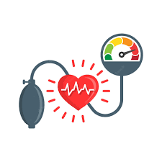
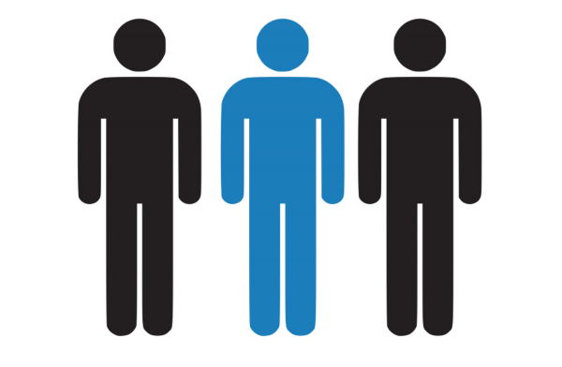
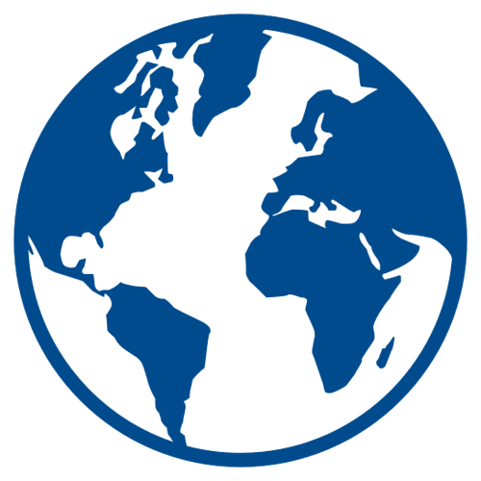

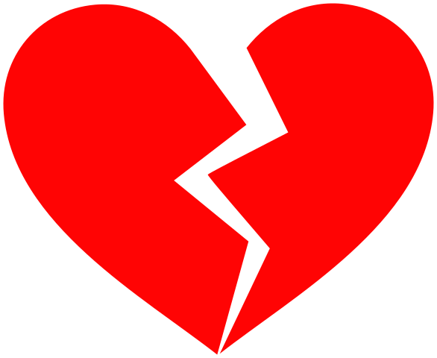

Have you checked your blood pressure recently?
1 in 3 men
140/90
Reducing Hypertension globally by 25% by 2025
Hypertension(high blood pressure) puts you at risk for death and disease
https://www.who.int/news-room/fact-sheets/detail/diabetes

